Slide 1
Kentucky All Schedule
Prescription Electronic Reporting
Quarterly Trend Report
4th Quarter 2024 Cabinet for Health and Family Services
Office of Inspector General
275 E. Main Street
Frankfort, KY 40621

Slide 2
KASPER Quarterly Trend Report for Q4 2024
Doses represented in the tables and maps in this presentation can be defined as follows:
“Doses is the Metric Quantity of the drugs prescribed and dispensed to patients. Doses forms include tablets, capsules, etc.”

Slide 3
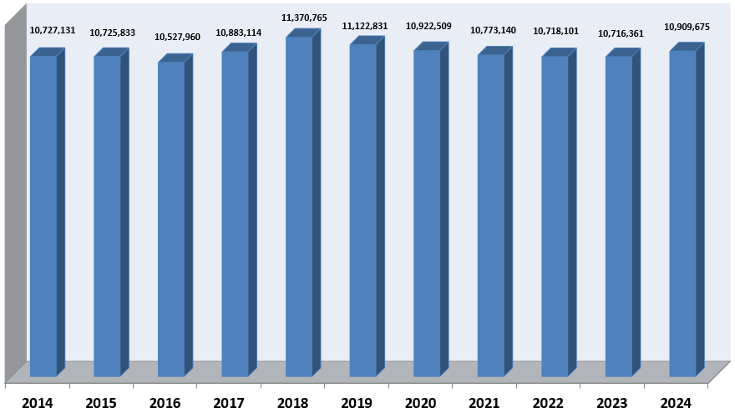
KASPER Records Added 2014 – Q4 2024

Slide 4
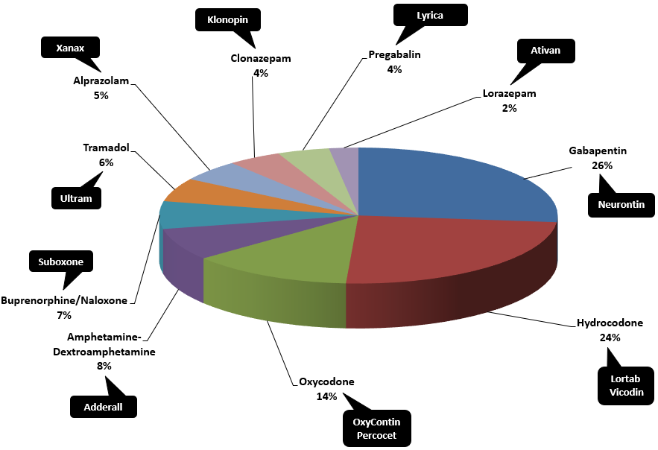
Top Prescribed Controlled Substances by Therapeutic Category by Doses – Q4 2024

Slide 5
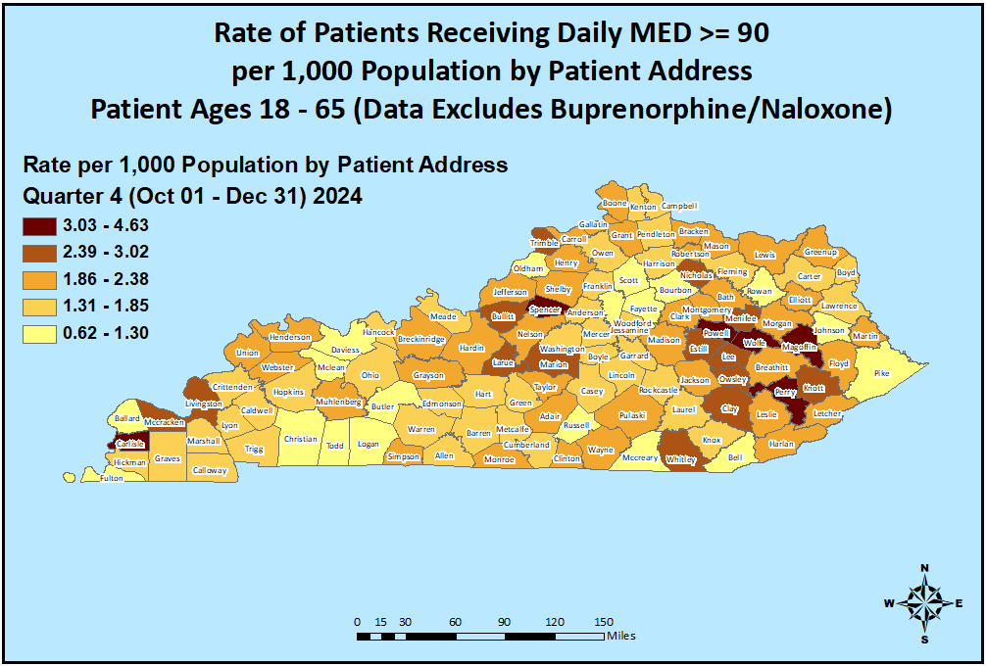
Opioid Morphine Equivalent Dose (MED) Data Q4 2024

Slide 6
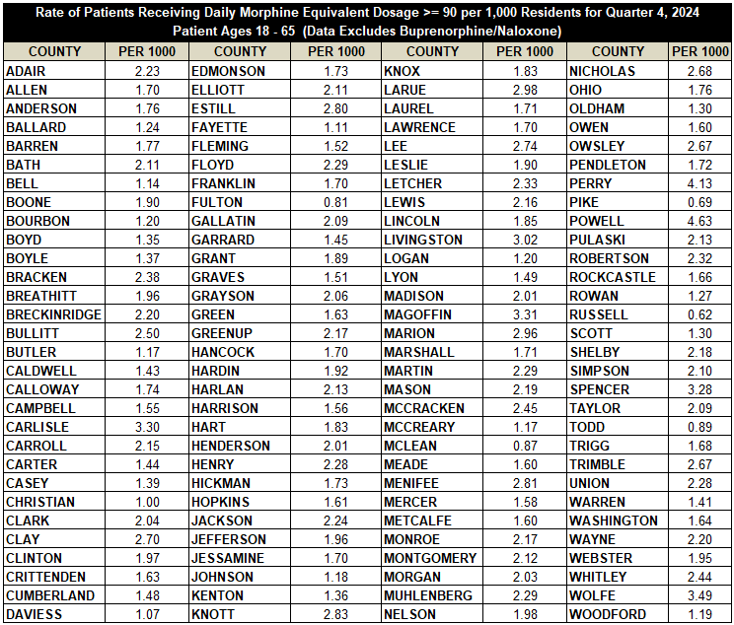
Opioid Morphine Equivalent Dose (MED) Data Q4 2024

Slide 7
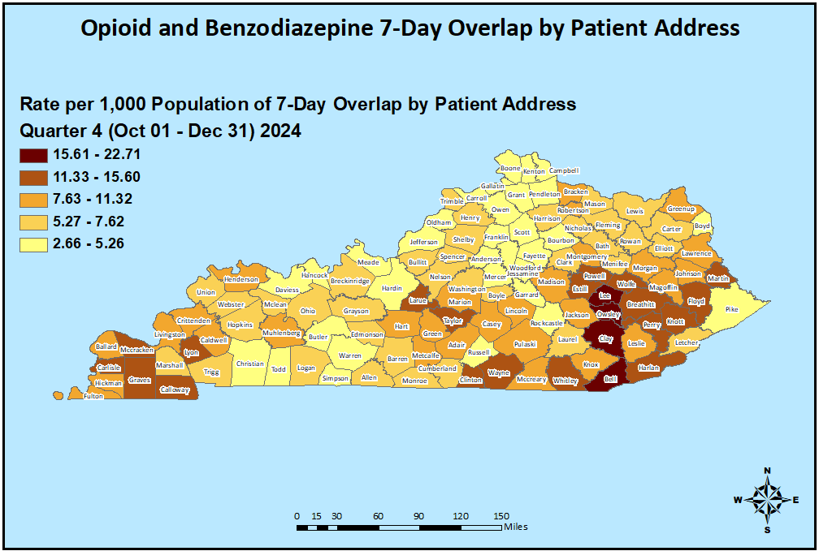
Patients with Seven or More Days of Overlapping Opioid
and Benzodiazepine Prescriptions Q4 2024

Slide 8
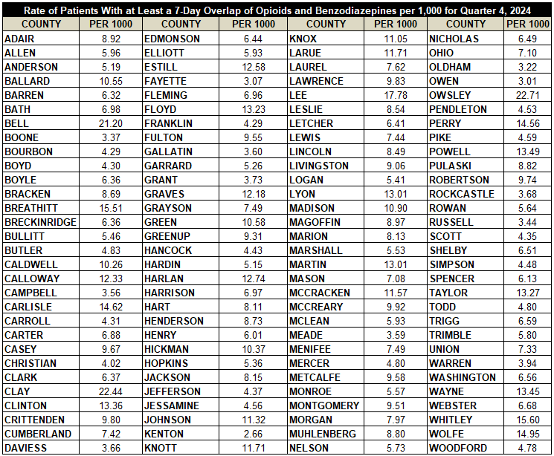
Patients with Seven or More Days of Overlapping Opioid
and Benzodiazepine Prescriptions Q4 2024

Slide 9
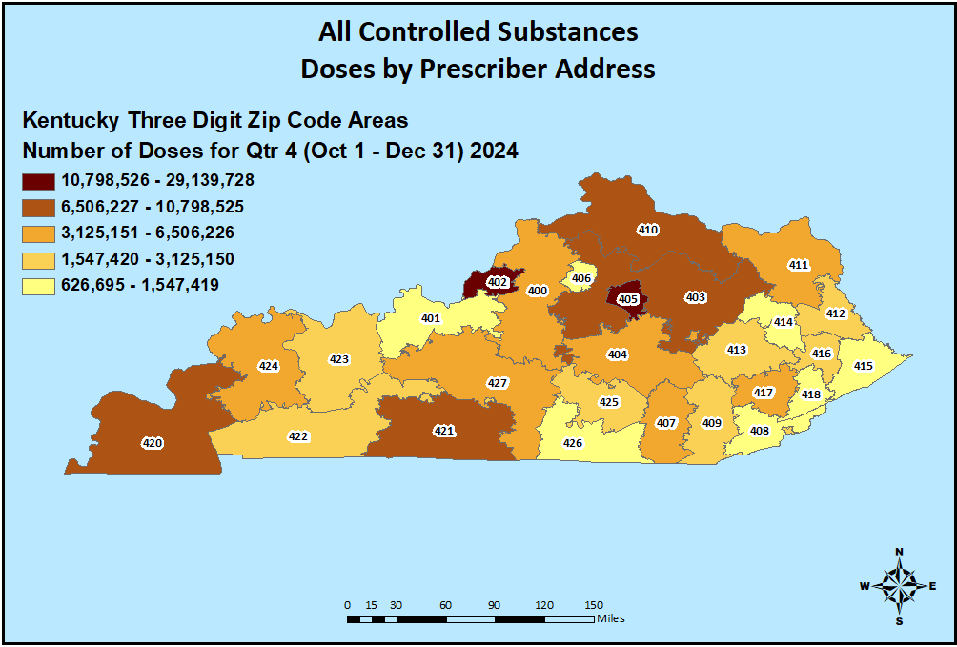
Controlled Substance Prescribing Q4 2024

Slide 10
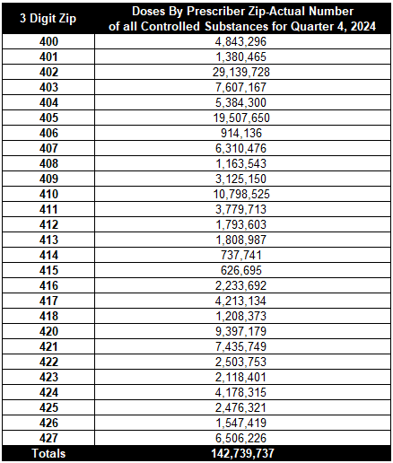
Controlled Substance Prescribing Q4 2024

Slide 11
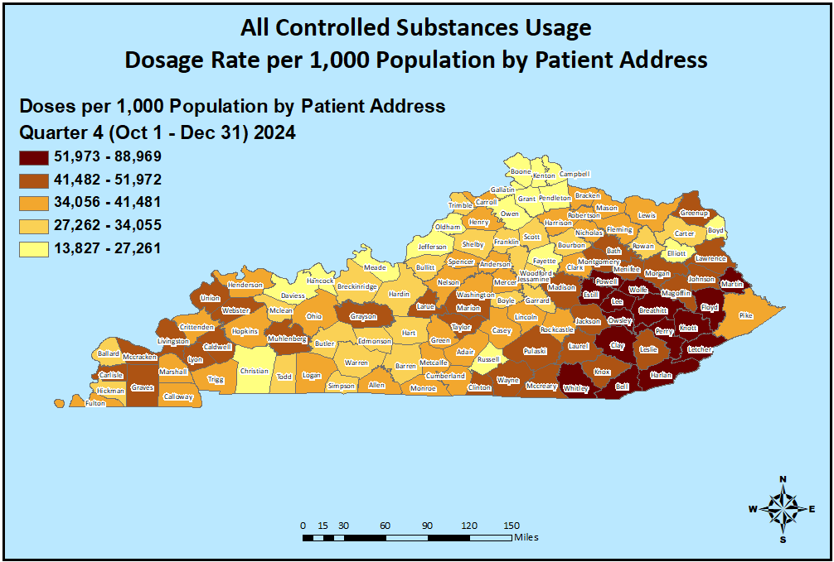
Controlled Substance Usage Q4 2024

Slide 12
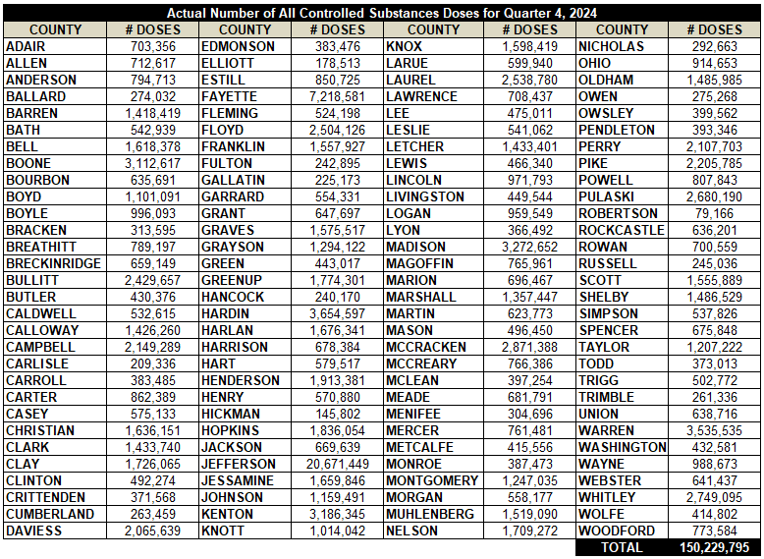
Controlled Substance Usage Q4 2024

Slide 13
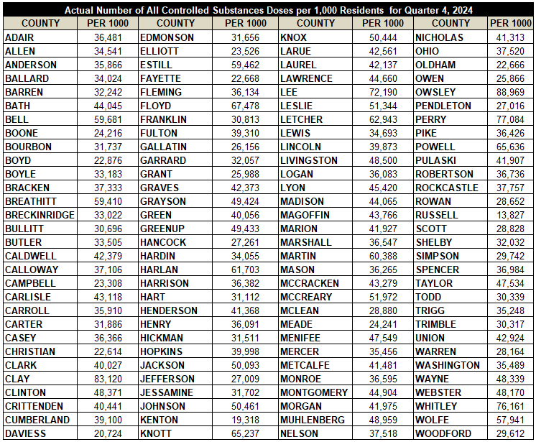
Controlled Substance Usage Per 1,000 Population Q4 2024

Slide 14
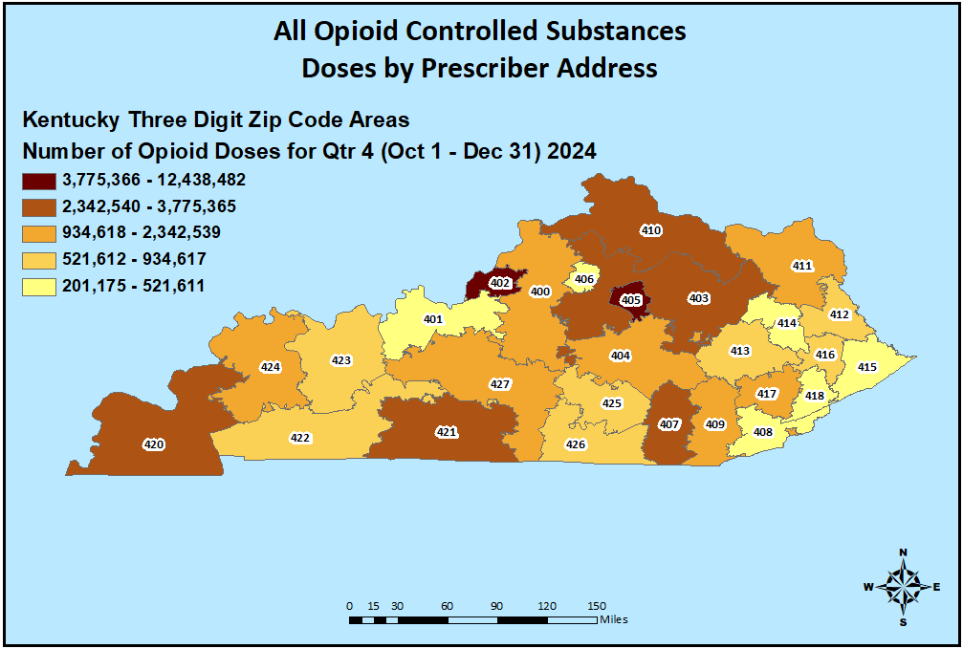
Opioid Prescribing Q4 2024

Slide 15
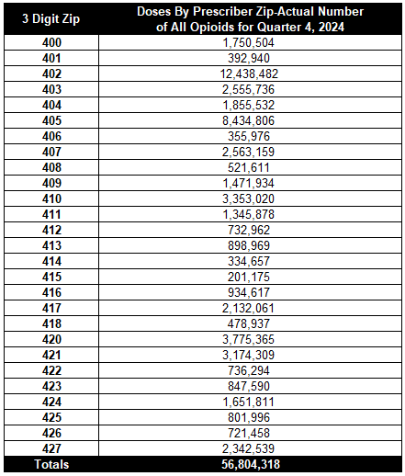
Opioid Prescribing Q4 2024

Slide 16
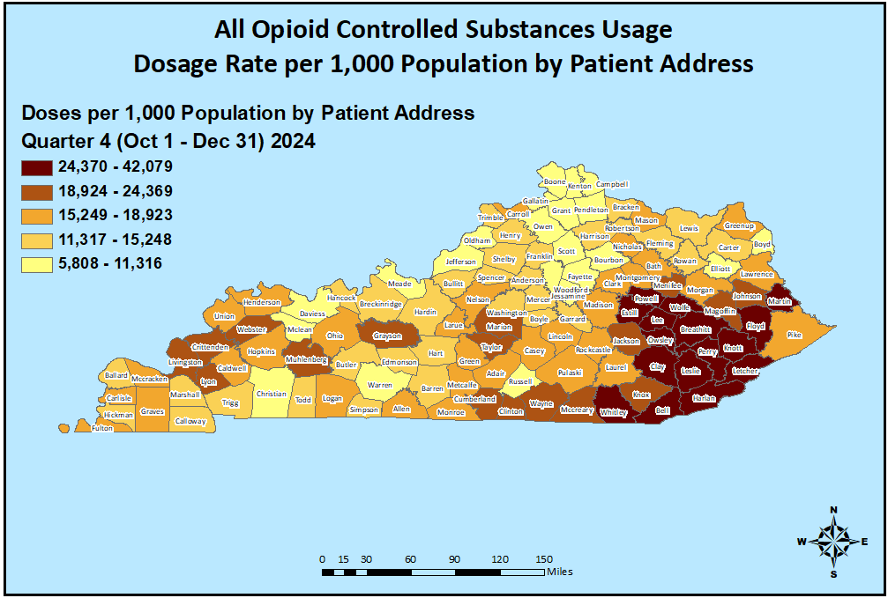
Opioid Usage Q4 2024

Slide 17
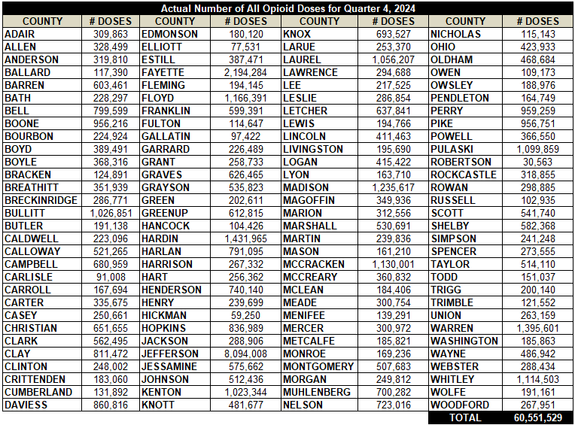
Opioid Usage Q4 2024

Slide 18
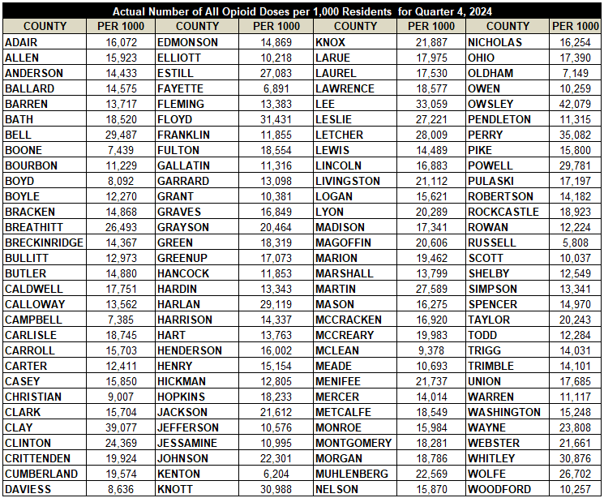
Opioid Usage Per 1,000 Population Q4 2024

Slide 19
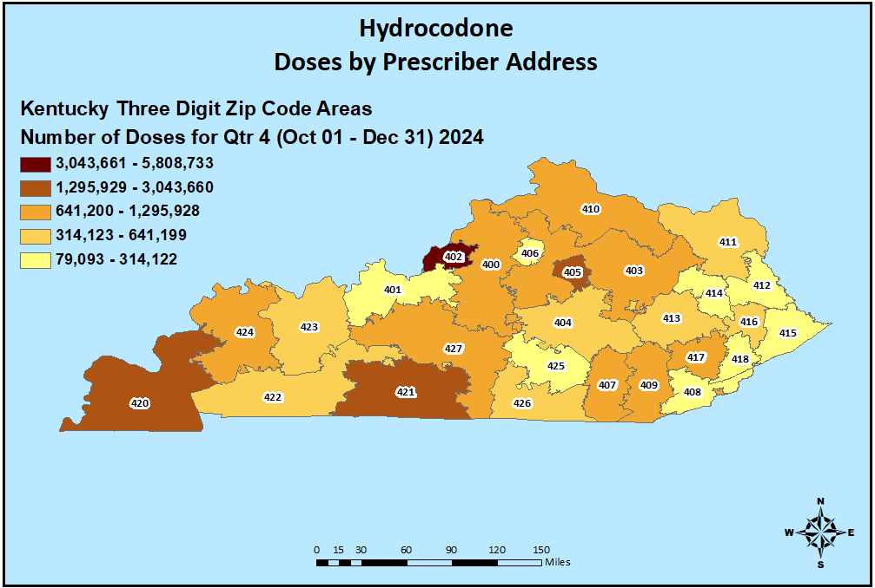
Hydrocodone Prescribing Q4 2024

Slide 20
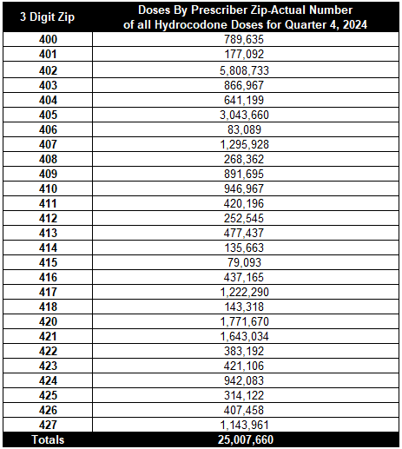
Hydrocodone Prescribing Q4 2024

Slide 21
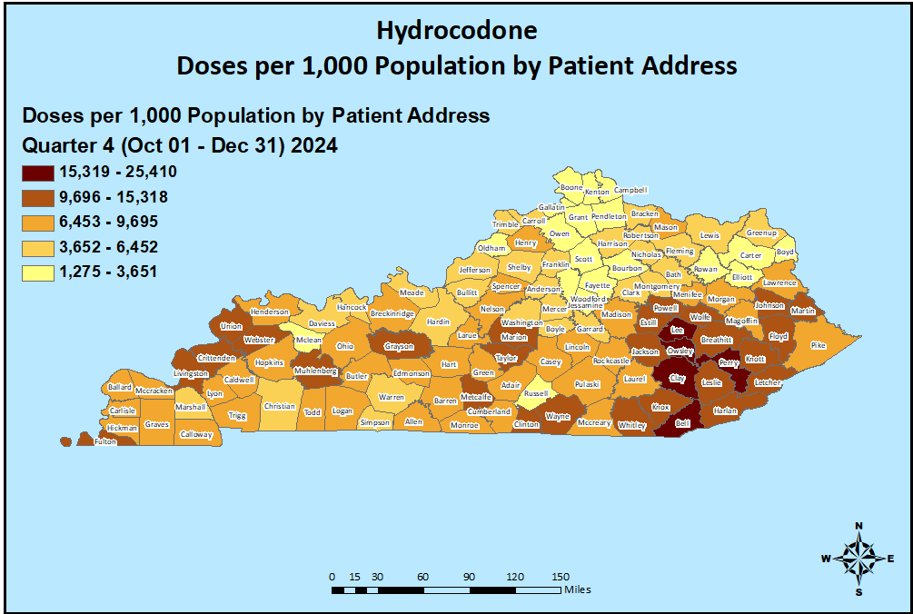
Hydrocodone Usage Q4 2024

Slide 22
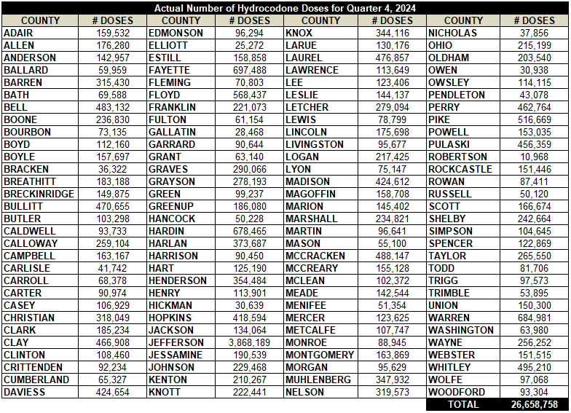
Hydrocodone Usage Q4 2024

Slide 23
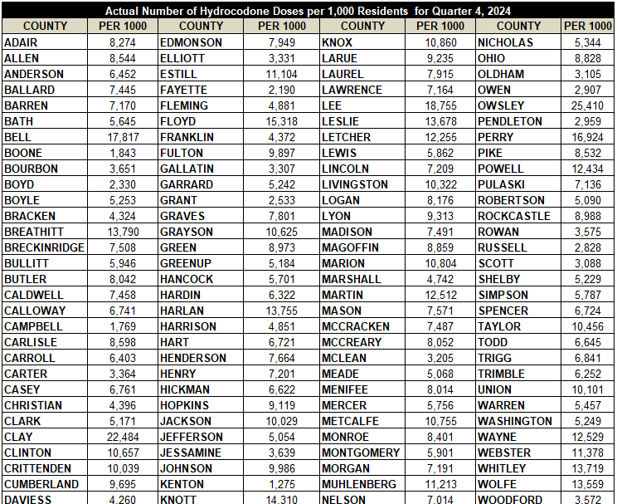
Hydrocodone Usage Per 1,000 Population Q4 2024

Slide 24
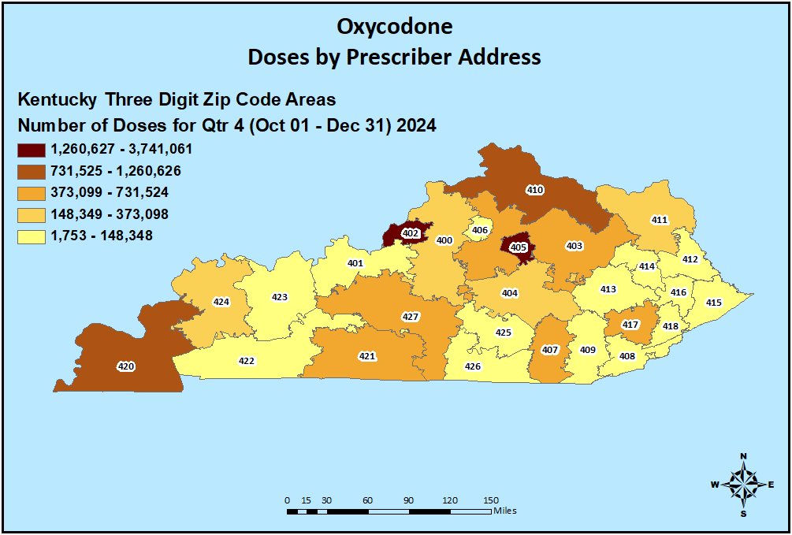
Oxycodone Prescribing Q4 2024

Slide 25
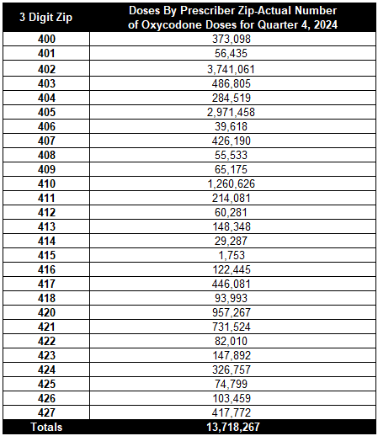
Oxycodone Prescribing Q4 2024

Slide 26
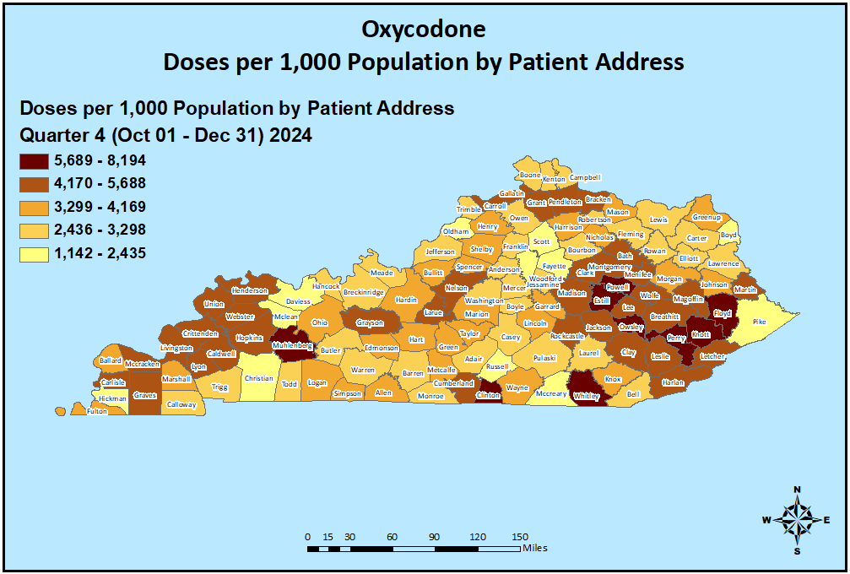
Oxycodone Usage Q4 2024

Slide 27
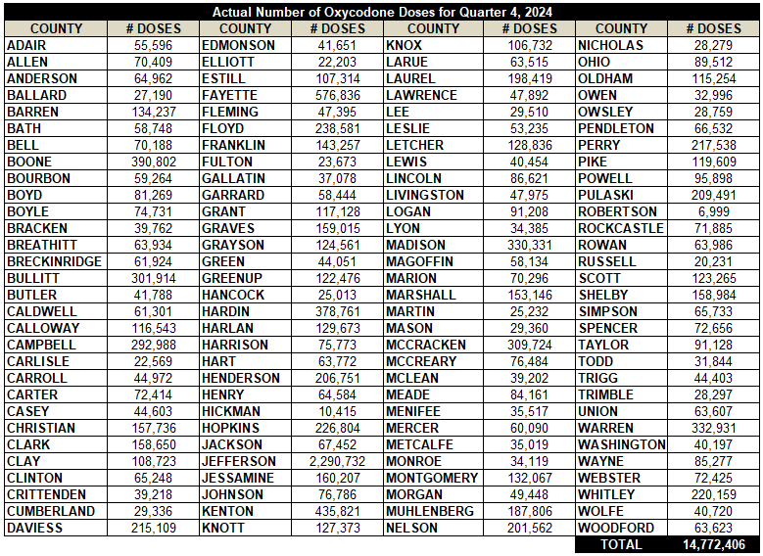
Oxycodone Usage Q4 2024

Slide 28
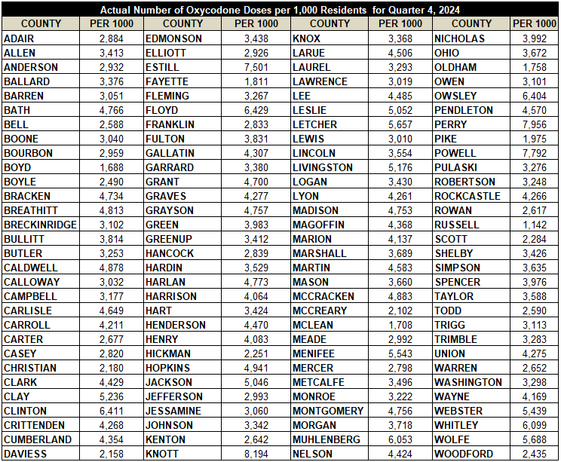
Oxycodone Usage Per 1,000 Population Q4 2024

Slide 29
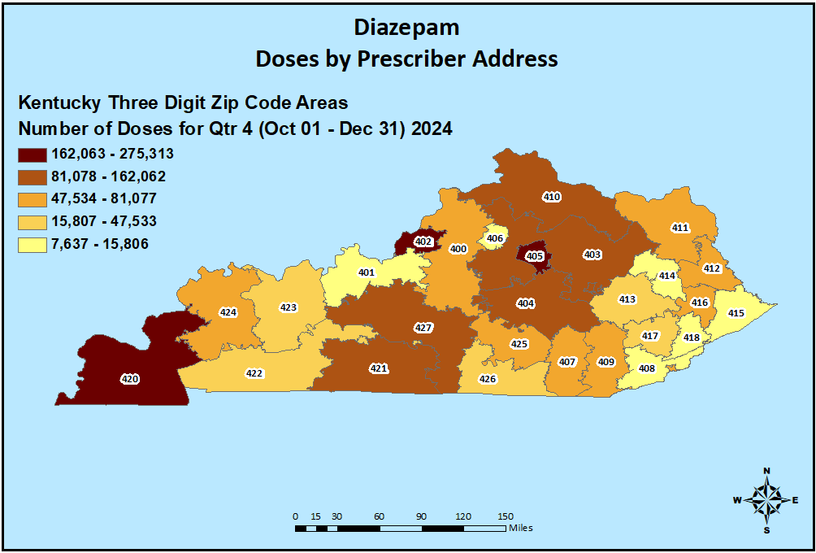
Diazepam Prescribing Q4 2024

Slide 30
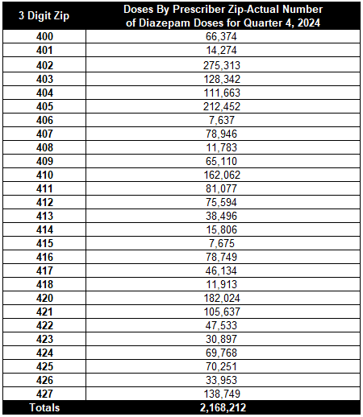
Diazepam Prescribing Q4 2024

Slide 31
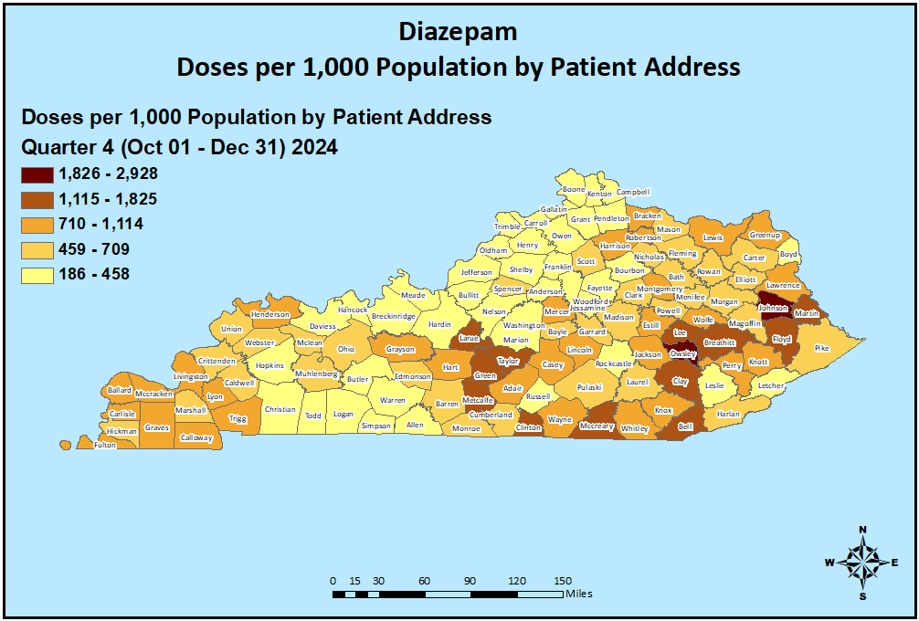
Diazepam Usage Q4 2024

Slide 32
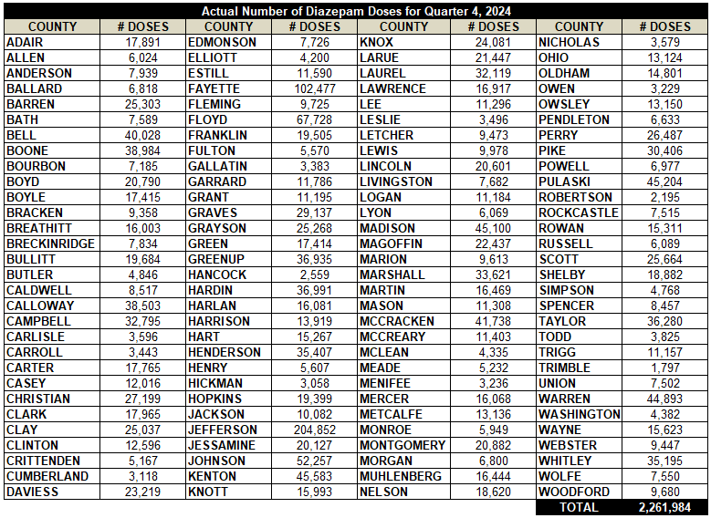
Diazepam Usage Q4 2024

Slide 33
Diazepam Usage Per 1,000 Population Q4 2024

Slide 34
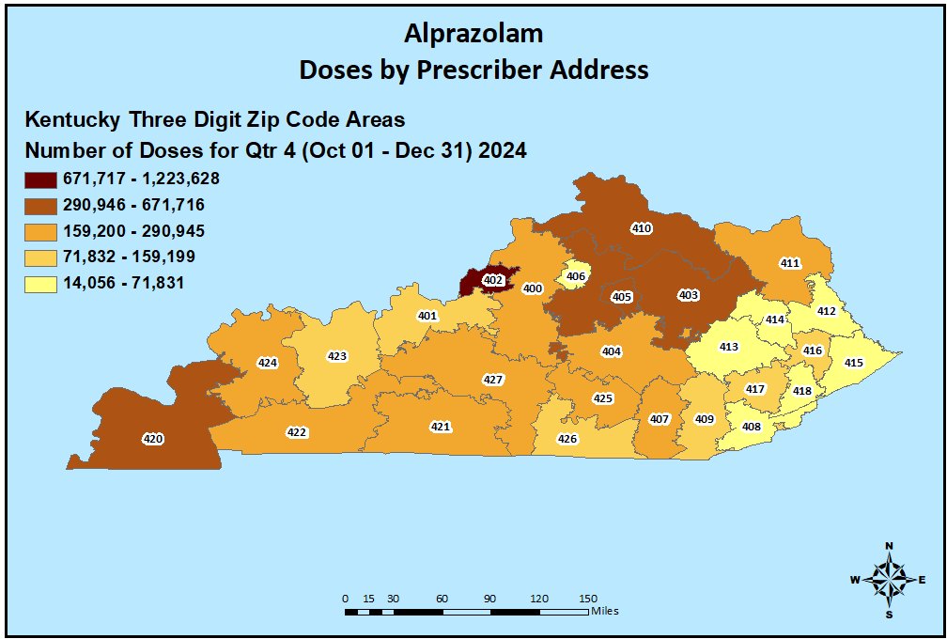
Alprazolam Prescribing Q4 2024

Slide 35
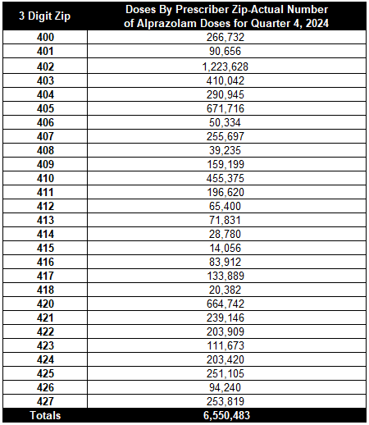
Alprazolam Prescribing Q4 2024

Slide 36
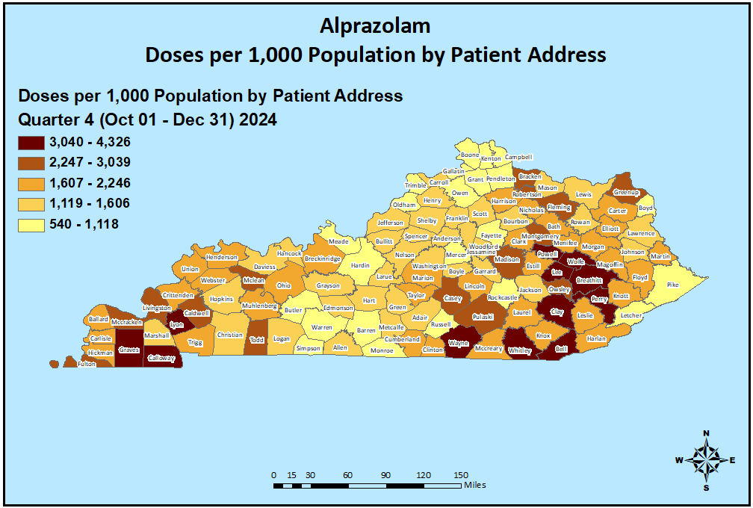
Alprazolam Usage Q4 2024

Slide 37
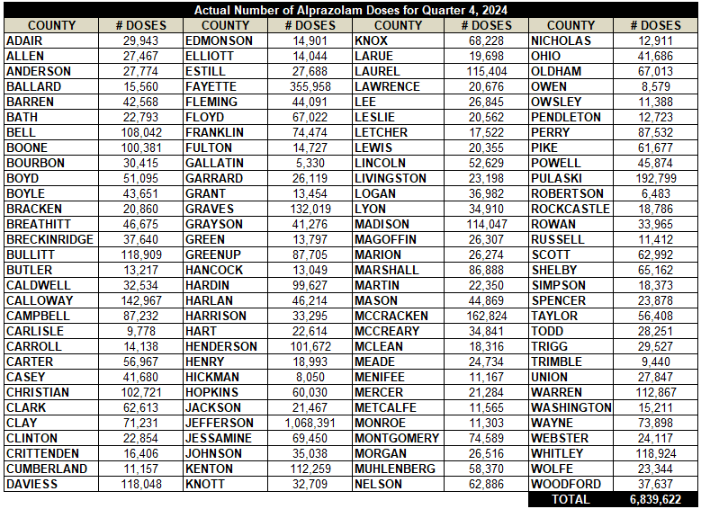
Alprazolam Usage Q4 2024

Slide 38
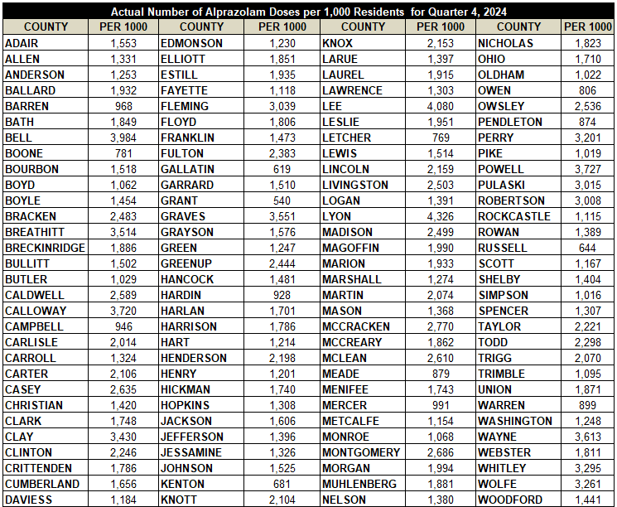
Alprazolam Usage Per 1,000 Population Q4 2024

Slide 39
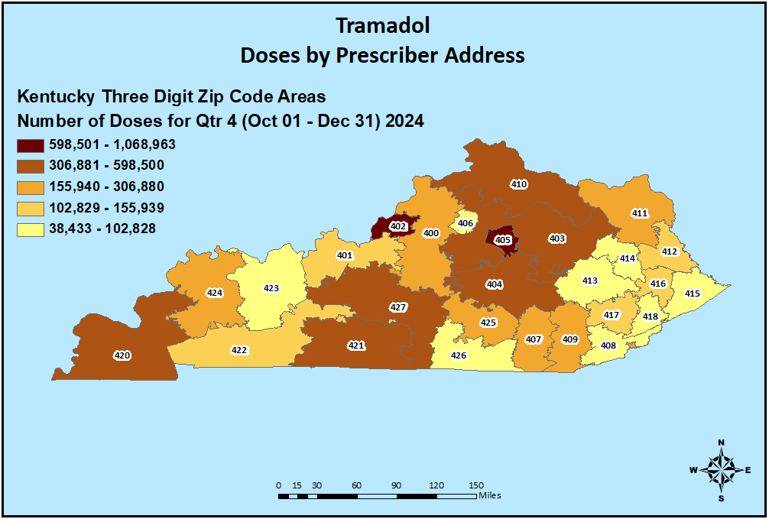
Tramadol Prescribing Q4 2024

Slide 40
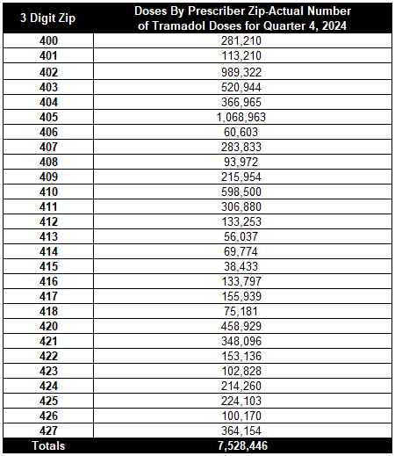
Tramadol Prescribing Q4 2024

Slide 41
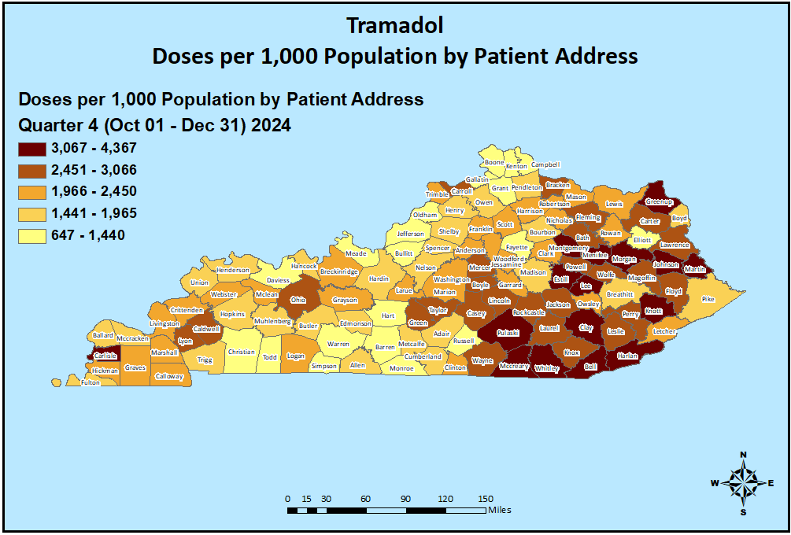
Tramadol Usage Q4 2024

Slide 42
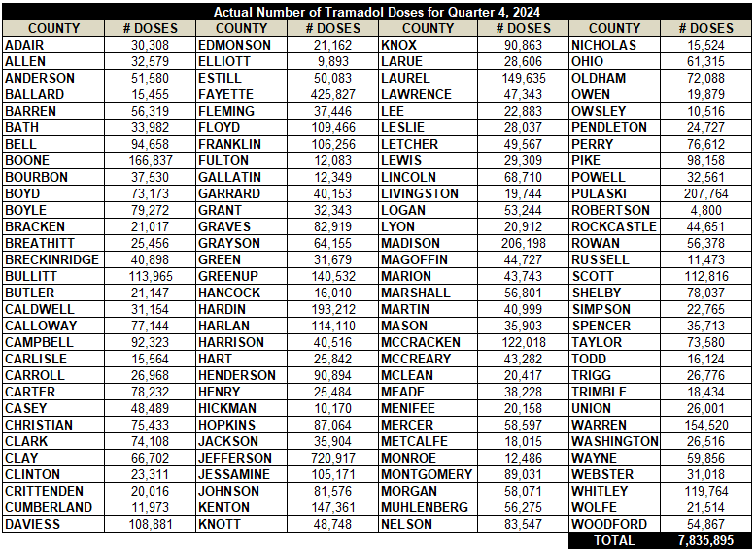
Tramadol Usage Q4 2024

Slide 43
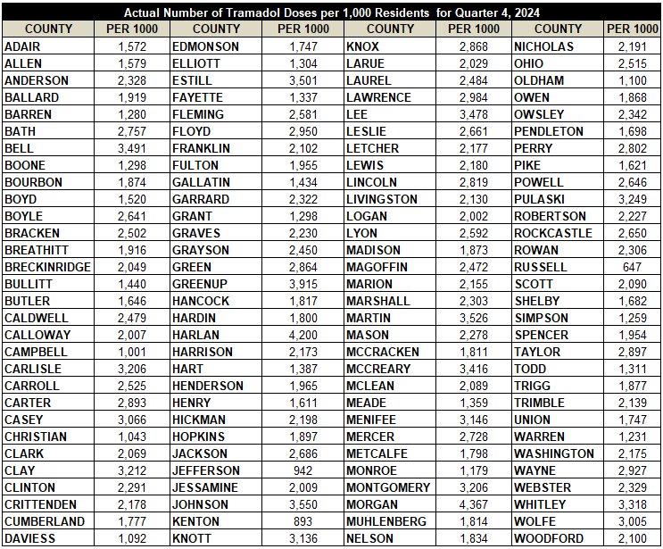
Tramadol Usage Per 1,000 Population Q4 2024

Slide 44
Gabapentin Prescribing Q4 2024

Slide 45
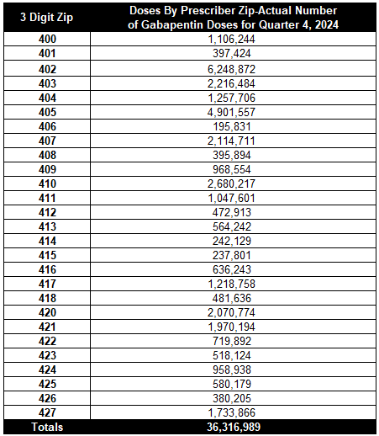
Gabapentin Prescribing Q4 2024

Slide 46
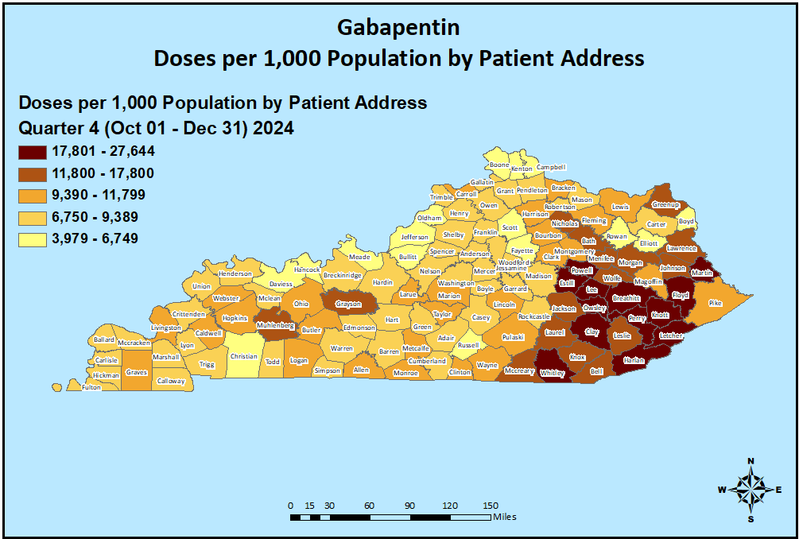
Gabapentin Usage Q4 2024

Slide 47
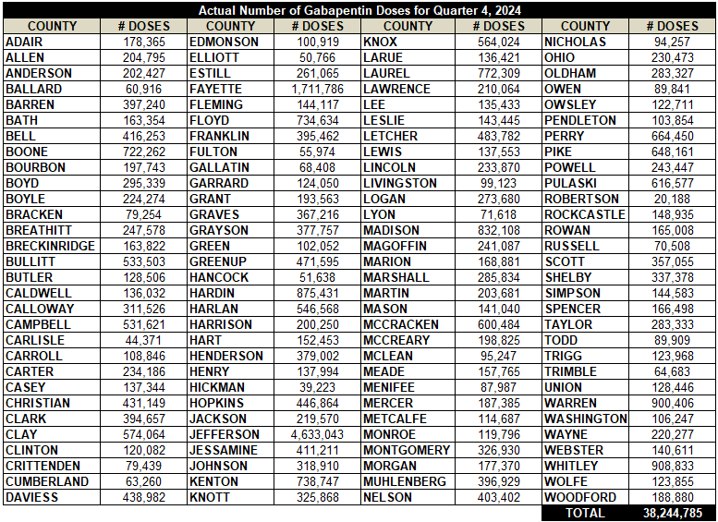
Gabapentin Usage Q4 2024

Slide 48
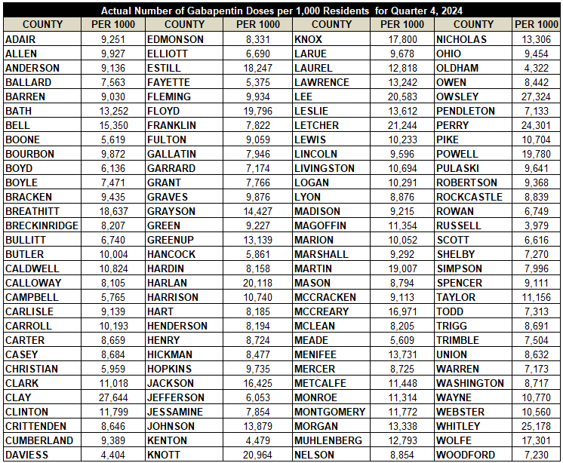
Gabapentin Usage Per 1,000 Population Q4 2024

Slide 49
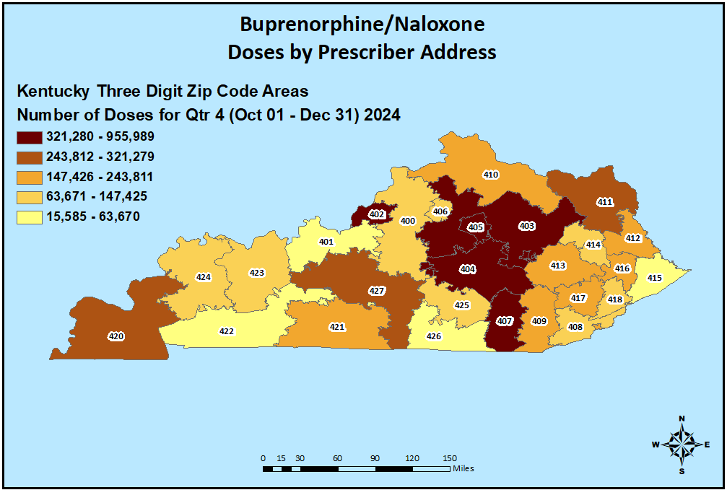
Buprenorphine/Naloxone Prescribing Q4 2024

Slide 50
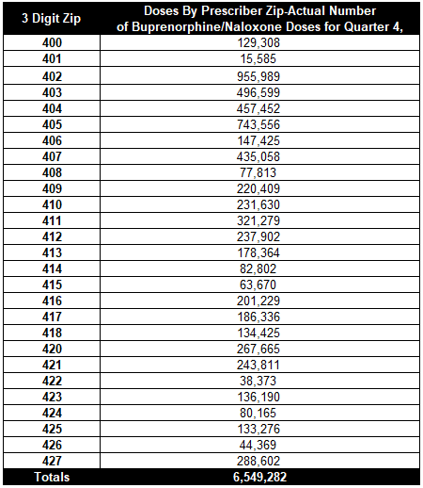
Buprenorphine/Naloxone Prescribing Q4 2024

Slide 51
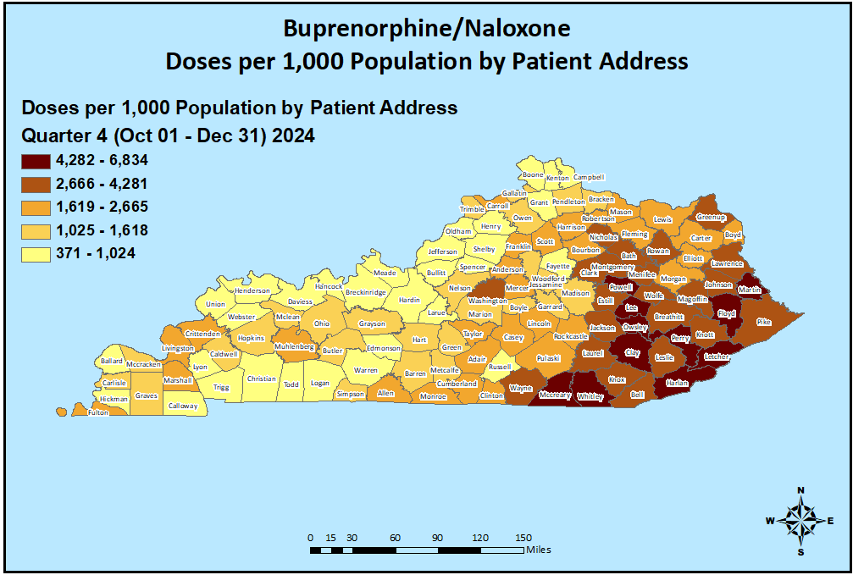
Buprenorphine/Naloxone Usage Q4 2024

Slide 52
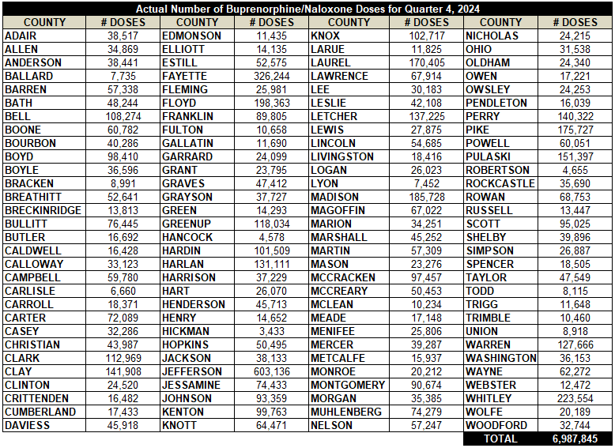
Buprenorphine/Naloxone Usage Q4 2024

Slide 53
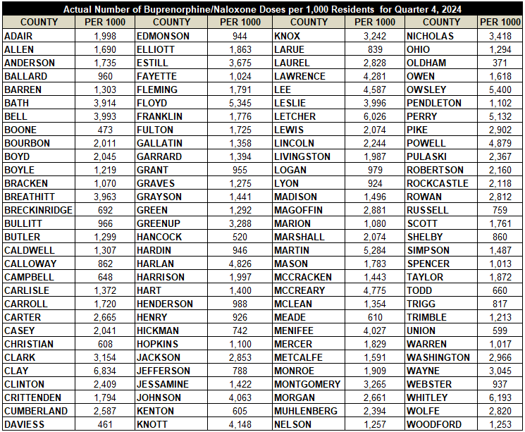
Buprenorphine/Naloxone Usage Per 1,000 Population Q4 2024

Slide 54
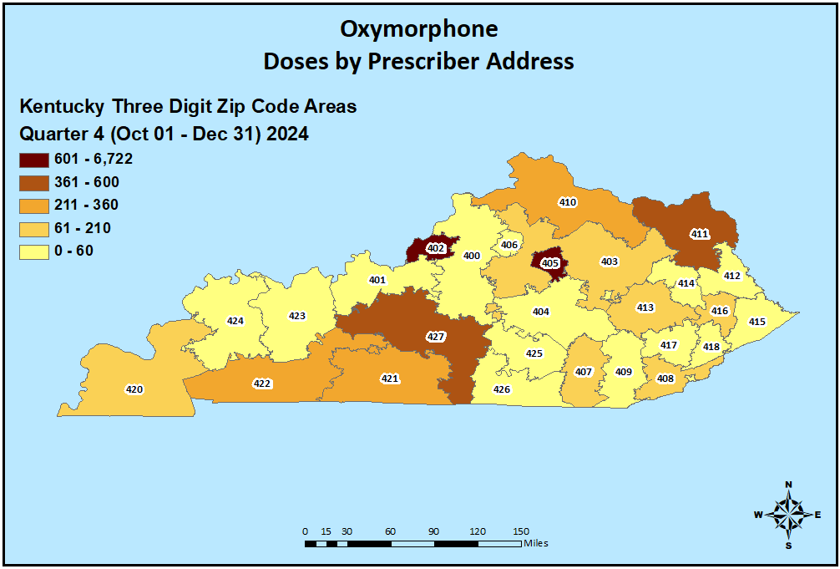
Oxymorphone Prescribing Q4 2024

Slide 55
Oxymorphone Prescribing Q4 2024

Slide 56
Oxymorphone Usage Q4 2024

Slide 57
Oxymorphone Usage Q4 2024

Slide 58
Oxymorphone Usage Per 1,000 Population Q4 2024

